Slide 1


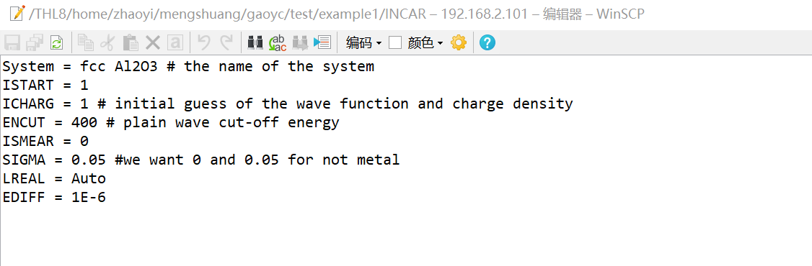
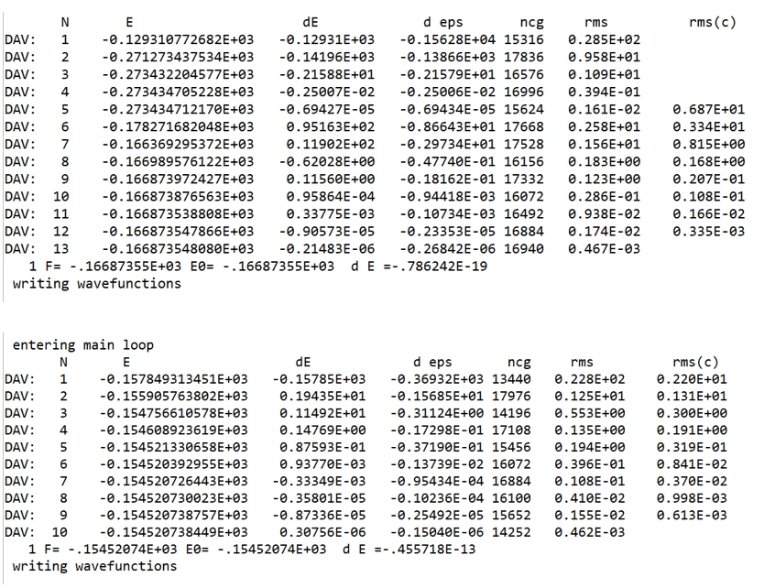
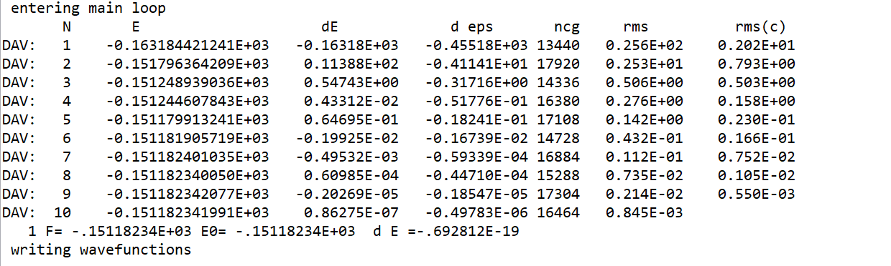
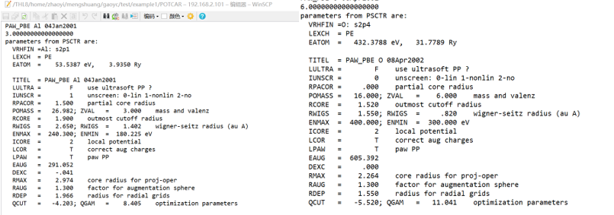
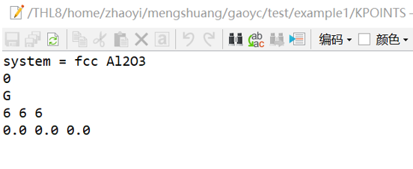
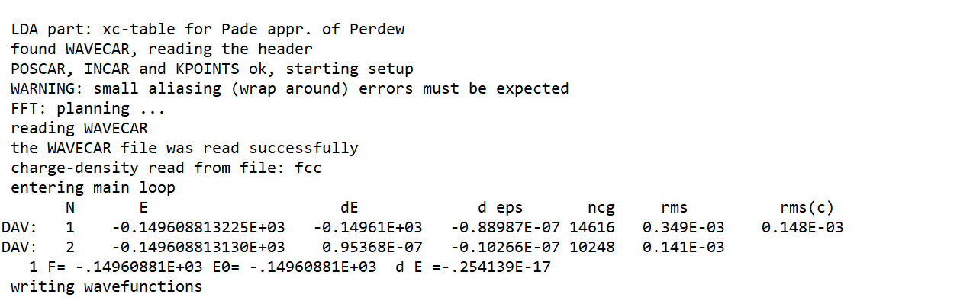
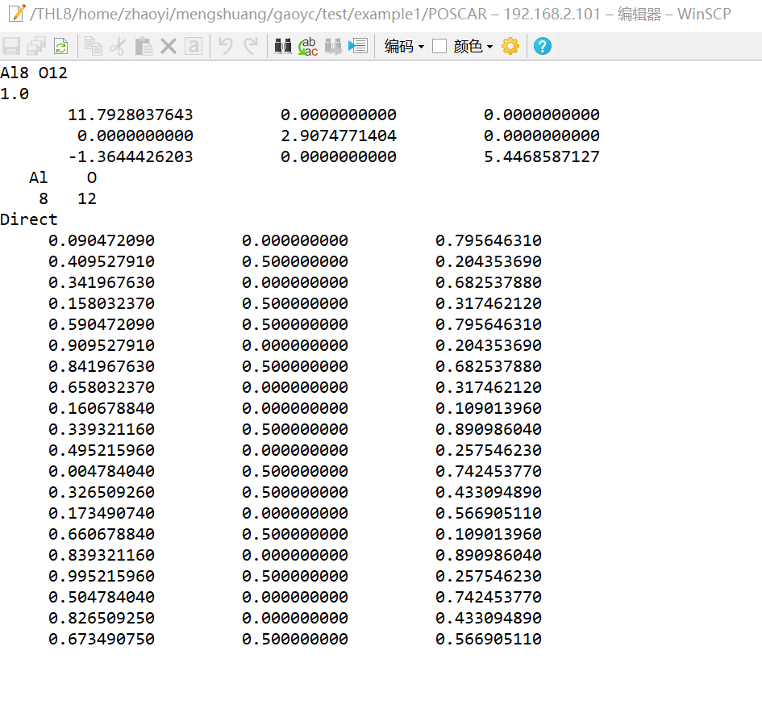
example of the test. The name of each directory is the value of ENCUT I want to test in different cases. Applying different types and values of basic wave functions, we can get the proper convergence energy. After using different values and using the same other 3 input files to calculate, we can focus on only the OUTCAR file to determine the energy.(I will only show several cases to clarify) Test cases for ENCUT = 100,200,300
We can see the times of iteration comes to a steady pace after ENCUT = 200, (the last row entry of the table). So the proper value of the ENCUT would be around 200. If requiring a more specific value, we need to do test between 200 and 300(the result is approximately 240, which matches the suggestion given on the forum).
2.2 Structure Analysis
There is one clue that AlN resembles a lot with AlScN so we can cut in by using the structure analysis of different AlN cells. Like this(hex). Here is the result of the observation: 1.Band Gap Characteristics : AlN typically exhibits a direct band gap, Band gap width is approximately 6.2 eV (calculated using HSE06 functional) 2.Density of States (DOS) Analysis Total DOS : Valence band top is primarily contributed by N 2p orbitals. Conduction band bottom is mainly composed of Al 3s and 3p orbitals Projected DOS (PDOS):N atom:2s orbital shows significant contribution in the range of -15 eV to -12 eV, 2p orbital dominates at the valence band top (-6 eV to 0 eV) Al atom:3s and 3p orbitals have notable contributions at the conduction band bottom (above 6 eV) Fermi Level : Located in the middle of the band gap, approximately at 3.1 eV
The Emulation of Ferroelectric Materials Based on First Principle.
and O and put the two together. This file includes information about the scattering properties of atoms, designed to reproduce atomic properties over a wide energy range. For GW calculations, it's recommended to use POTCAR files with the "_GW" suffix, which are constructed over a larger energy range suitable for calculating many unoccupied states. The header of the POTCAR file contains important information such as the element name, type of exchange-correlation functional, and atomic energy. The POTCAR file determines the type of pseudopotential used in the calculation, such as van der Waals corrections or ultrasoft pseudopotentials. Different types of calculations may require different POTCAR files, such as those for GGA or LDA calculations. The file also includes initial charge density information, which is used in the first few steps of the calculation.
1.2.4 KPOINTS
K point means the k point in First Brillouin zone. This is a very simple file including the name on the line 1. 0 stands for grid which is generated by program itself, then G represents Gamma centered M-P grids which is the method the program would use to generate grids. Then 6,6,6 represents the number of k points per grid you want to get in three directions. Then three floating number at the last line is the shift distance of the grid, 0 represents no shift.
1.3Important Output Files
1.3.1OUTCAR
OUTCAR itself is a very large file containing all the messages that VASP calculated. So I only take the STD.OUT file to stress the most important part of the OUTCAR. First few lines are about whether the program successfully operates. Entering the main loop brings the program in calculating the converge energy of the system.(SCF iterations), DAV means the method of the iteration which is the Blocked Davidson Iteration Schema. N is the current step, E is the current energy, dE and deps is the energy difference which should be less than 0.00001 to represent convergence. In this case for Al2O3, it is successfully converged at the second step with the final output F and E0 and dE.
Part2 : Some tests
2.1 convergence test
As mentioned in INCAR file, there requires initial guess about the charge density and the wave function, the method to get a perfect initial guess is to apply convergence test. Still, we use Al2O3 as an
Introduction
Ferroelectric (FE) materials display very peculiar structural, electrical, and electromechanical features. Nowadays, many properties can be accurately computed and predicted from first principles for a given FE material. Even more important, the work of the last decade has revolutionized our qualitative view of the phenomenon of ferroelectricity at large. There are major advances concerning structural and lattice-dynamical properties, spontaneous and induced polarization, dielectric and piezoelectric properties, and structural phase transitions at finite temperature. Special attention is devoted to illustrating the novel methods which made such advances possible. So in this report, I want to focus on what I have done so far during the summer research and, since the work is still unfinished, I will also focus on what I will be doing in the next few months.
Part 1:
1.1Introduction to VASP
VASP, short for Vienna Ab initio Simulation Package is a tool used for computing atomic-scale materials modeling, particularly for electronic structure calculations and quantum-mechanical molecular dynamics simulations. It is widely employed in materials science, condensed matter physics, and computational chemistry research. The thing that makes life easier about VASP is its calculation is based on First Principle and Density Functional Theory, so it only requires atomic numbers and fundamental equations of quantum mechanics as inputs. There are four inputs files that users need to create: INCAR, POSCAR, POTCAR and KPOINTS. So from now on, I will use Al2O3 as an example to analyze these four input files.
1.2Four Input Files
1.2.1 INCAR
This is the file relating to basic requirements that users want to implement. Line 1 is the name of the system which can be anything. line 2 and 3 contains the initial guess of the wave function and charge density, ISTART is 1 if WAVECAR(file containing the basic information of the wave function) exists and should be used. ICHARG can be 0,1,2,4,10,11,12 depending on what charge density users want to guess(usually takes 2 at the beginning of the trial). Line 4 contains ENCUT which is the most important parameter of the wave function: the value of it reflects the cut-off energy of the plain wave, which is related to probability function. Line 5 is smear value, which represents the difference between the highest Fermi energy band and the lowest Fermi energy band. We take 0 for Gaussian Smearing in this experiment. Line 6 represents whether this material is a semiconductor or metal or insulator. 0.05 for insulator or semiconductor and 0.2 for metal. The next two lines are depending on actual situation, meaning it can be ignored or added. For example the last line represents the energy difference between different iterations.
1.2.2 POSCAR
It starts with the name in line 1 which is the same situation. Then number 1.0 in line 2 is the scaling parameter, depending on how large users want the cells to be. Then 3*3 net parameters is the information of the vectors in three directions, if it is greater than 0, then it represents the length of the sides. If it is zero there may have zero length which in other words, a vertical. Direct means this calculation is based on Direct coordination rather than Cartesian or something else. Every line represents a coordinate of the atom inside one cells. Actually, this input file can be fetched from the pseudopotential library, which contains the information of all existing components.
1.2.3 POTCAR
This is only a small part of POTCAR, which is quite a large file. Same as POSCAR, users need to download from pseudopotential library. The POTCAR file contains pseudopotential information for each element. For systems with multiple elements, individual POTCAR files need to be concatenated in the order of elements listed in the POSCAR file. In this example I download both the Al

